Slide 1
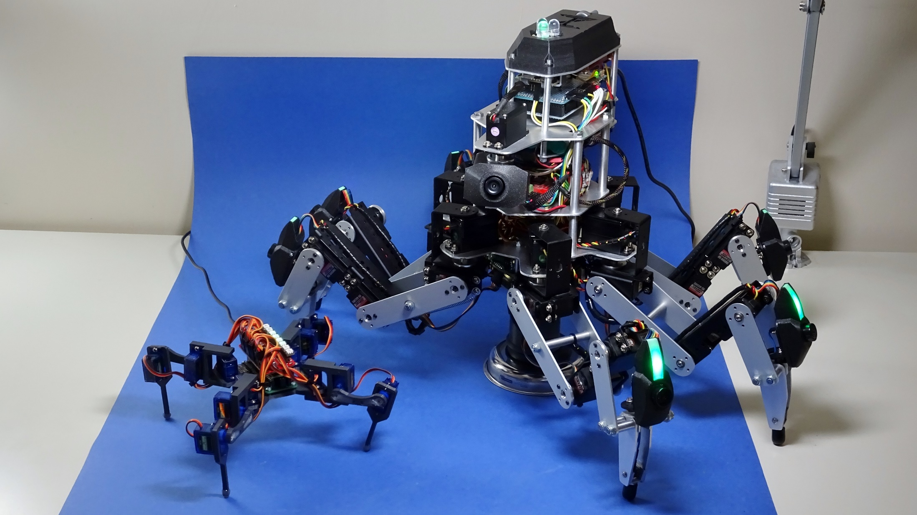
Will your next Pi Wars entry be a Walker?
The challenges of multi-legged robots
Dr. Christopher Parrott
Notes:
Today I am going to be talking about the challenges of multi-legged robots, and what you need to think about if building one yourself for entry into PiWars

Slide 2
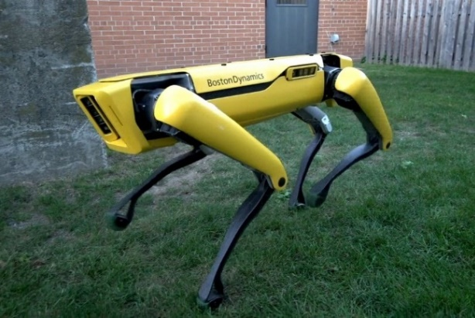
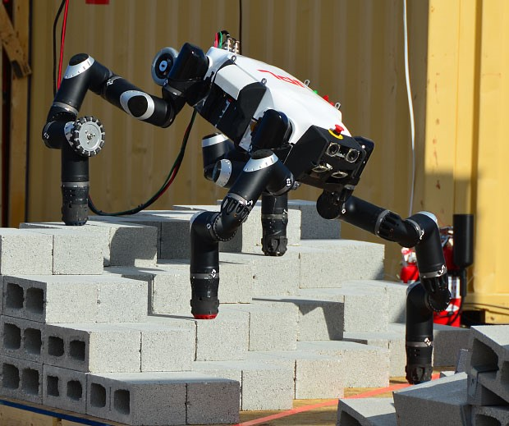
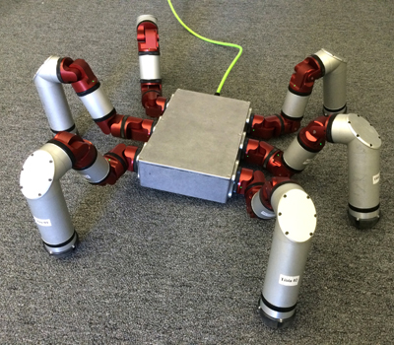
Walkers
You too can build a walking robot!
SpotMini [1]
Mantis [2]
Asimo [3]
RoboSimian [4]
Snake Monster [5]
Notes:
When you think of a walker, chances are robots like these come to mind
Seeing these may give the impression that these robots are hard for the average maker to build
Today I would like to show you that is not the case!
First let me give you a bit of background of how I got in to walking robots

Slide 3
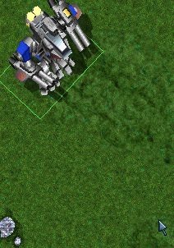
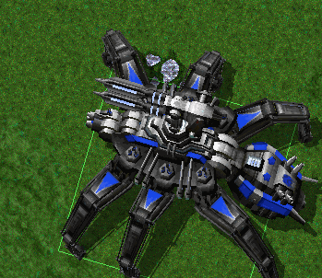
Walkers & Me
Started by modding walkers into the video game Total Annihilation
Joined the Lynxmotion forum and learnt to build my own hexapod
Went on to do a PhD in Robotics
Explored walkers in simulation
Recently been building walkers at work for inspecting water pipes

Slide 4
Why a Walker?
Can move in any direction
Can adapt to rough ground
Body height, position and angle are adjustable
Lots of moving parts
Complex to control
Slower than other movement options
They’re Cool!!

Slide 5
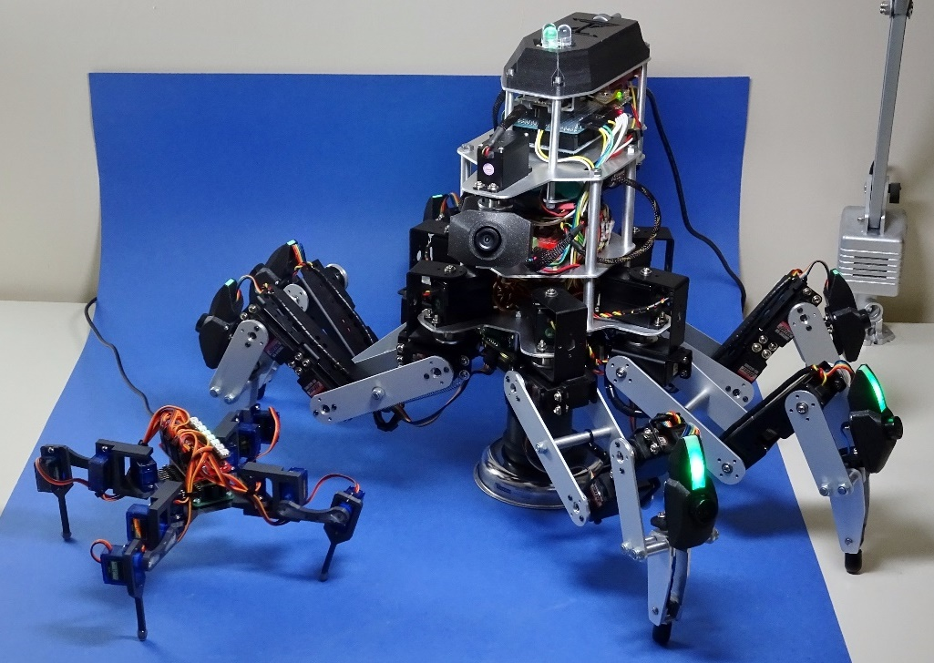
Deciding on a Walker
How many legs?
Biped (two legs)
Quadruped (four legs)
Hexapod (six legs)
Octopod (eight legs)
Number of joints per leg?
3 minimum for spider-like
6 minimum for biped-like
Walking on rough ground?
Needs contact sensors in feet

Slide 6
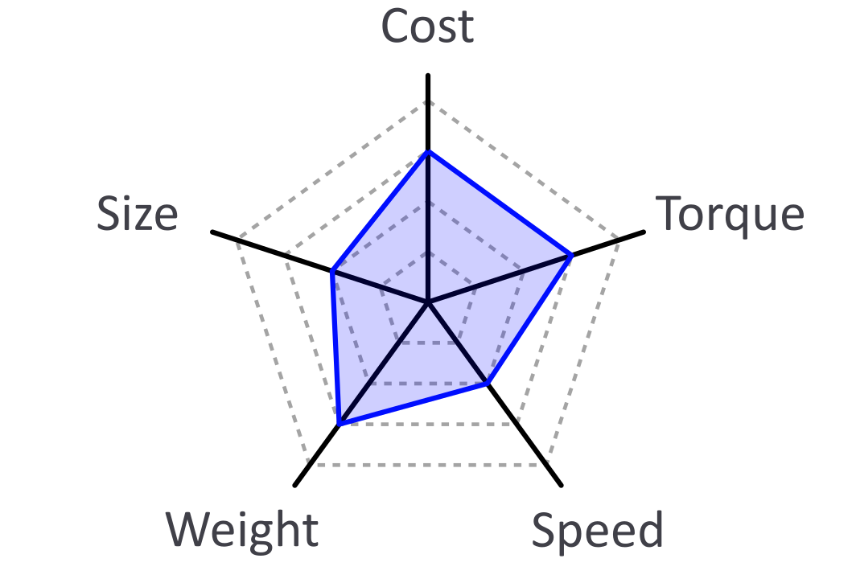
Joint Motors
Servos are ideal for joints!
Motor with built-in feedback loop
Goes to and stays at an angle you tell it to
Considerations

Slide 7
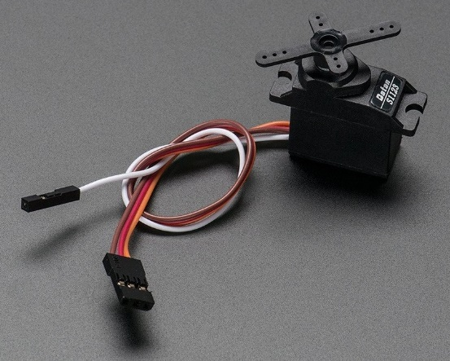
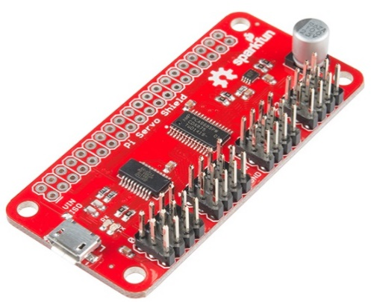
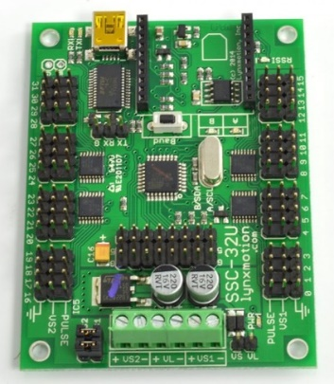
Servo Options
Hobby Servos
PWM controlled
Proportional feedback only
Hackable to add analog output for reading angle (or can buy)
Hitec Servo [6]
Adafruit Analog Feedback Servo [7]
Servo Drivers
Many options for up to 16 servos
Fewer for more (no HATs yet)
None have connections for extra pin of analog output servos
Sparkfun Pi Servo HAT [8]
Lynxmotion SSC-32U [9]

Slide 8
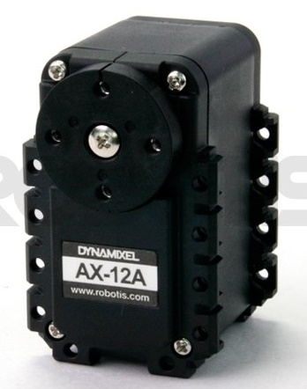
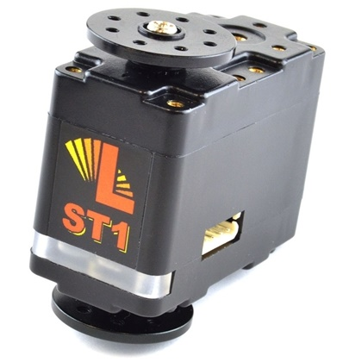
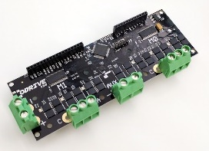
Servo Options
Smart Servos
Specifically designed for robotics
Built-in PID feedback loop
On a communication bus
Can read angle, current, temp etc
Dynamixel [10]
Lynxmotion SS [11]
DIY Servos
Motor + Encoder + Driver + Microcontroller
Off-the-shelf options available
Mechaduino [12]
ODrive [13]

Slide 9
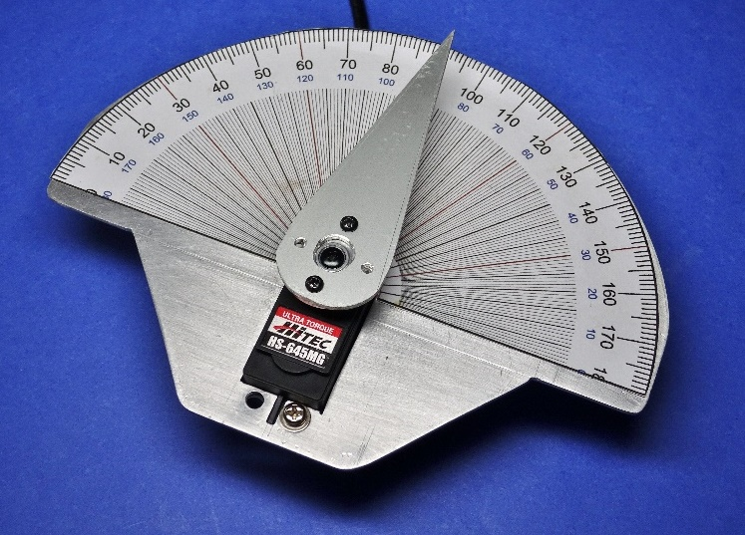
Hardware Tips
Calibrate your servos!
-90 and +90, and 0 degree values
If your robot is heavy, calibrate upside down or under load
Go for metal gear servos if possible
Add springs to legs to reduce load
Place heaviest parts at the centre

Slide 10
How to Walk
How to move each leg to touch a position in space
How to move those positions in a way that creates walking
How to stay balanced (optional)

Slide 11
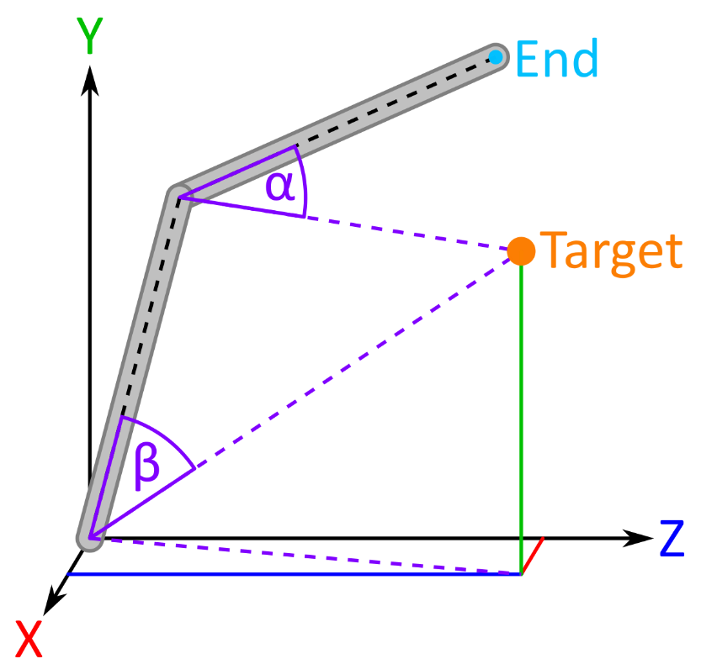
Inverse Kinematics (IK)
Find the joint angles of a leg that place its end at a target
Solvable with Trigonometry!
3 joints has 2 solutions (under and over)
Higher joint counts have many more!
Find one by grouping joints together
Or add directions for some to aim in

Slide 12
Gait (Walking Pattern)
A repeating cycle of steps that are taken by a set of legs to achieve movement in a direction
Biped
Quadruped

Slide 13
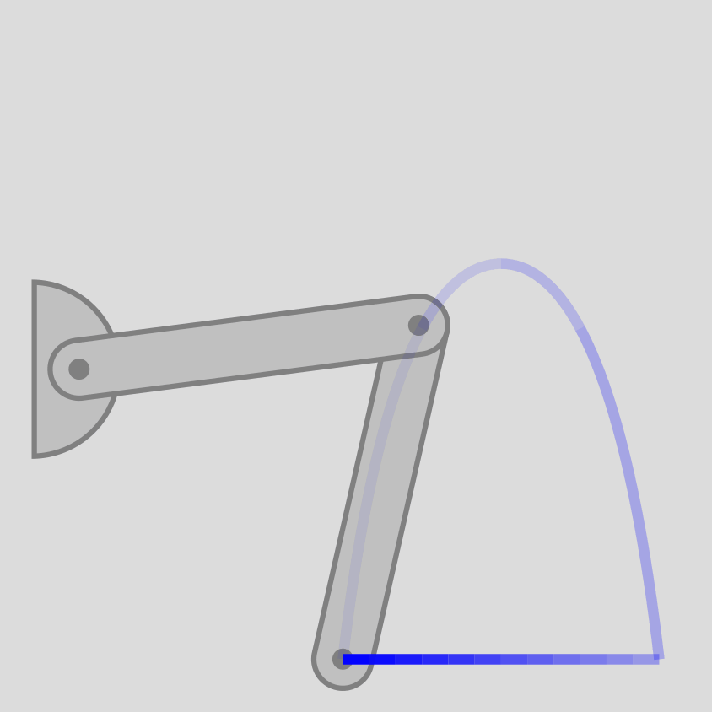
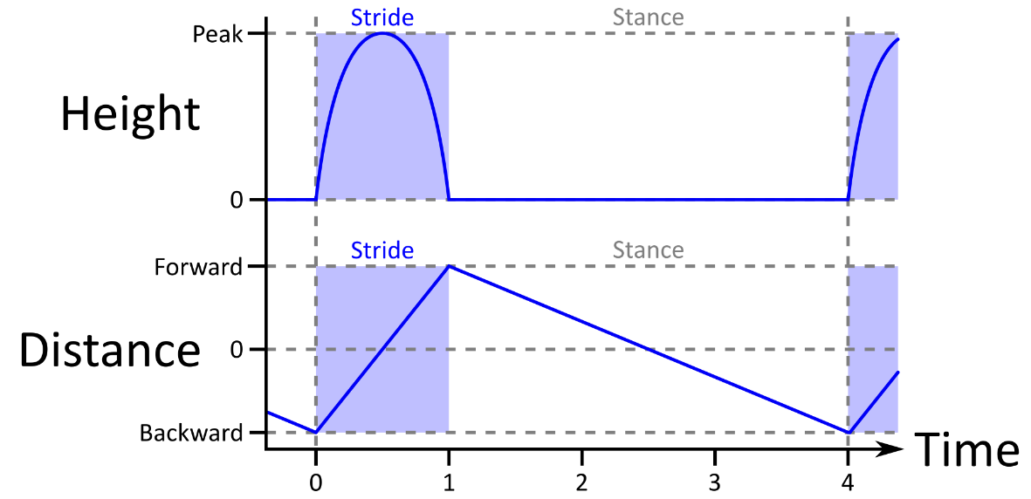
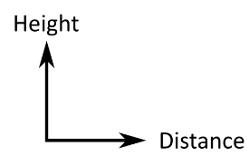
Gait Generation
Convert a gait to offsets for each leg’s idle target position

Slide 14
Balancing
Dynamic
Static
Make continual corrections to avoid falling over
Move robot’s centre to be within the legs that are on the ground

Slide 15
Will your next Pi Wars entry be a Walker?
Highly recommended if you are looking for a new challenge!
Will learn new things about robotics and get a cool new robot
To get you started my walking simulator is now on Github!
May make a custom HAT that does everything onboard too

Slide 16
Thanks for listening!
Twitter: @ZodiusInfuser
YouTube: youtube.com/user/ZodiusInfuser
Website: zodiusinfuser.uk

Slide 17
Image References
[1] https://www.businessinsider.com/boston-dynamics-spot-robot-dog-going-on-sale-this-year-2019-6
[2] https://www.qimtek.co.uk/news/applied-measurements-submersible-load-cells-fitted-world-s-largest-all-terrain-hexapod
[3] https://spectrum.ieee.org/automaton/robotics/humanoids/humanoid-robots-rise
[4] https://scienceandtechnology.jpl.nasa.gov/research/research-topics-list/spacecraft-technologies/mobility-robotics
[5] https://www.cmu.edu/news/stories/archives/2015/january/reconfigurable-modular-robots.html
[6] http://www.modelshopleeds.co.uk/catalog/product_info.php?products_id=864
[7] https://www.adafruit.com/product/1449
[8] https://www.sparkfun.com/products/14328
[9] https://www.robotshop.com/uk/lynxmotion-ssc-32u-usb-servo-controller.html
[10] https://robosavvy.com/store/robotis-dynamixel-ax-12a.html
[11] http://www.lynxmotion.com/p-1126-lynxmotion-smart-servo-lss-motor-standard-st1.aspx
[12] https://tropical-labs.com/shop/mechaduino-0-2-servo/
[13] https://odriverobotics.com/

