Slide 1
Introduction to Proportional,
Integral, Differential (PID)
Control
or how to make your robot drive in a straight line
@lwr20

Slide 2
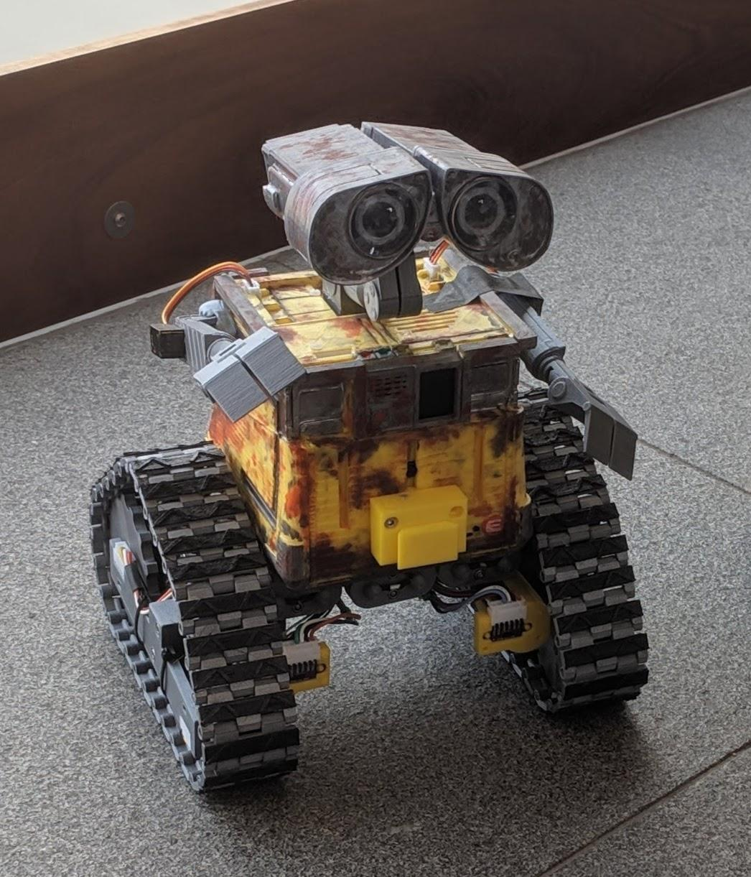
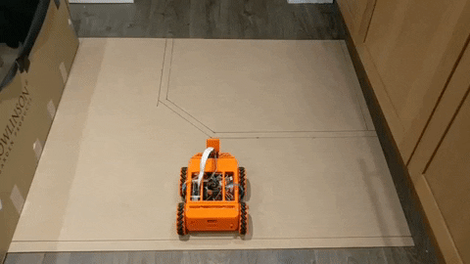
Why should you listen to me?
2020 will be the first PiWars I have not competed in
So I’ve learned a lot (i.e. made a lot of mistakes!)
Notes:
Wall-E was 2019 entry
Tigerbot (the orange one with mecanum wheels) was 2018 entry
You can find them both in the robot display area if you want to get a closer look

Slide 3
The Problem
My robot won’t drive in a straight line (when controlled by my program)
Different sized wheels
Wheels not mounted correctly
Because my motors don’t turn at the same speed.
Affected by:
Surface
Manufacturing tolerances
Dirt in bearings
Etc
This can also manifest as variability between autonomous runs
Notes:
Robot won’t drive straight.
Bunch of possible causes:
Manufacturing issues
Slightly different wheel size
Wheels not mounted straight on the chassis
Motors don’t turn at same speed:
Surface
Carpet vs wooden floor vs tiles vs gravel
Manufacturing tolerances - maybe the motors are just different?
Dirt in the bearings
Hair wrapped round the motor shaft - a big problem in my house
Can also manifest as variability between autonomous runs
When you run the minimal maze code, you find that the robot doesn’t finish in exactly the same spot each time

Slide 4
The Solution
Why does it drive straight when you control it directly?
Measure what you want to control
Is that position, speed or angle?
Write code to use the measurement to compensate!
Notes:
Why does it drive straight when you control it directly?
Because you’re watching it - when it drifts, you steer to compensate
So let’s break that down:
Measure what you want to control
Is that position, speed or angle?
Write code to use the measurement to compensate!

Slide 5
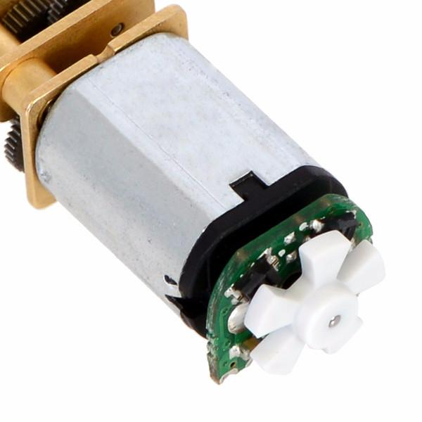
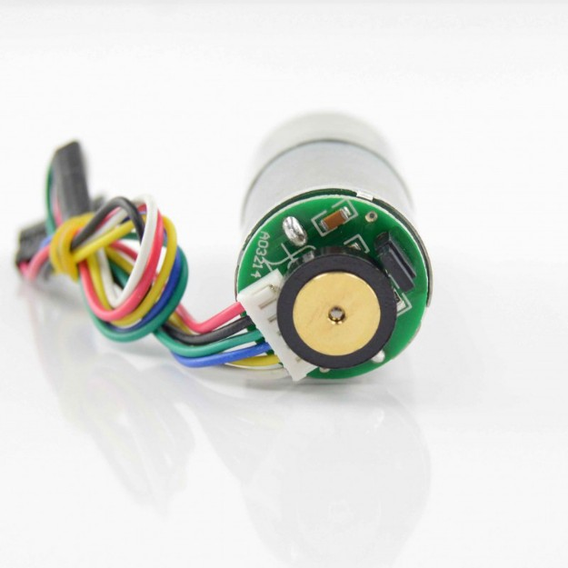
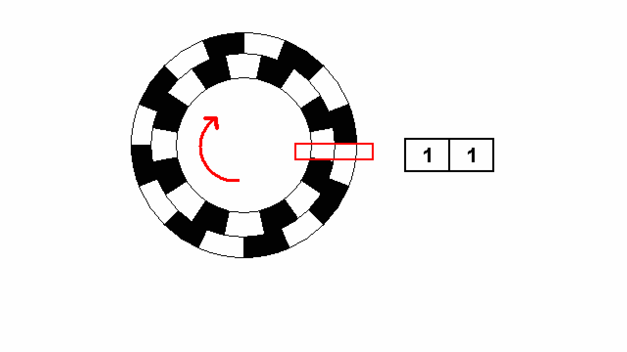
Measuring Position
Position
Encoders
Magnetic
Optical
“Quadrature”
Don’t lose count!
Dedicated microcontroller
Notes:
Pics show a couple of motors with encoders attached.
Left is a pololu micro metal gear motor (as used to be sold by Pimoroni - they’re about to start selling a magnetic one instead)
Has a slotted disk at the back and 2 light sensors (photo transistors)
Right is a pololu 25mm motor with encoder - used in both Tigerbot and Wall-E
Has a 48 CPR quadrature encoder and a selection of gearboxes. A typical one might be 20:1 - giving 980 counts per rev
These are often called Quadrature encoders - they output 2 pulse streams in quadrature.
The quadrature output tells you direction of rotation as well as giving you more resolution
For example if the current state is (1) 00, the next state will either be (4) 10 or (2) 01 depending on which way the motor is spinning
You need something to determine the direction, and then count the changes - pick one direction to count up and the other to count down
If you want to turn position into speed - its simply the difference between the counts at 2 different times.

Slide 6
Measuring Heading
Gyro
Typically Rate Gyros - i.e. give you rotation rate about X, Y, Z axes
If you mount it carefully, you only need to worry about one axis (no maths needed)
Need to integrate the output to get a heading.
Gyro Drift!
Compass
These give you an angle about X, Y, Z axes
Slower update rate
Affected by metal and magnets (e.g. motors!)
Combined unit
BNO055 Absolute Orientation Sensor
Combines compass and gyro readings, integrates, etc
Notes:
Rate gyros give you a rotation rate (think degrees per second) - often 3 values - one for each of X, Y, Z axes
Mount it so that one of the axes points in the direction you want to measure, then just ignore the other readings
Need to integrate the rate to turn it into an absolute heading
Gyro drift - generally at power up, the gyro doesn’t read 0. Need to take a bunch of samples while the robot is stationary and average them to get the current drift rate.
Then just take away that drift rate from all the measurements to get the real rate.
BUT drift rate can vary with time (often due to temperature or battery voltage changes), so you’ll need to recalibrate every so often
Compass measures earth’s magnetic field
Gives you an absolute heading directly, but
Slower update rate (the number of times per second you can get a reading from it)
Affected by metal and magnets. Oh - and don’t we have a couple of motors in this robot?...
Combined unit like the BNO055
Deals with all the hard stuff.
Has both gyros and a compass
Combines gyros and compass readings together to get an absolute heading
Read over I2C

Slide 7
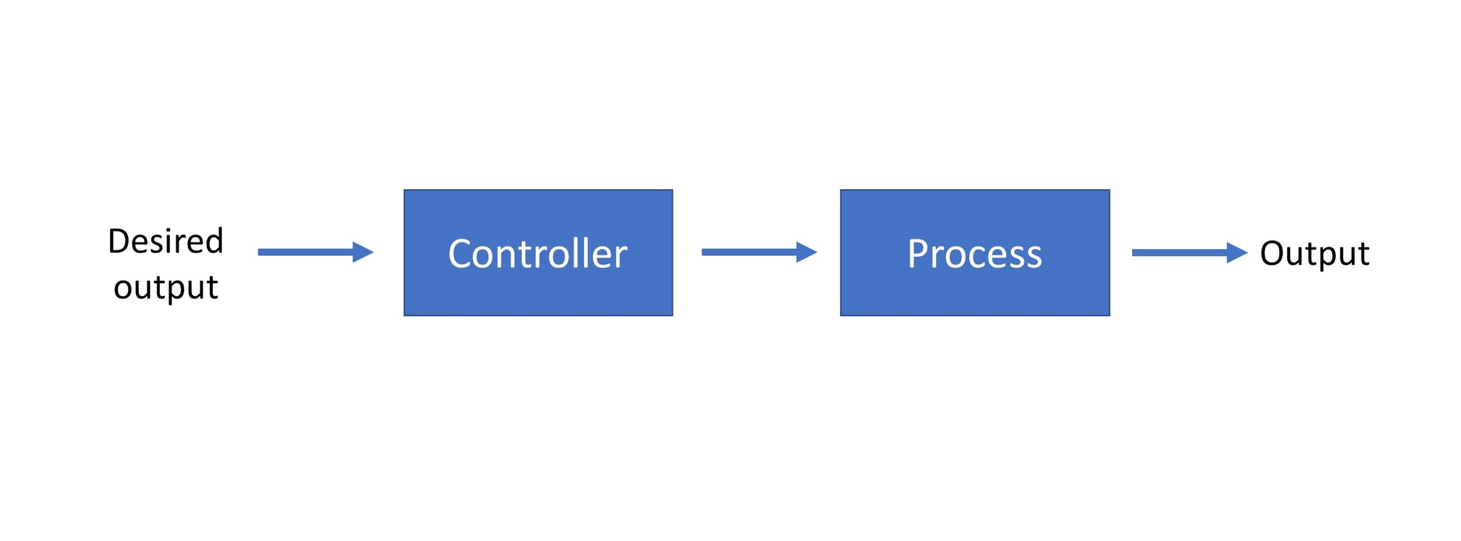
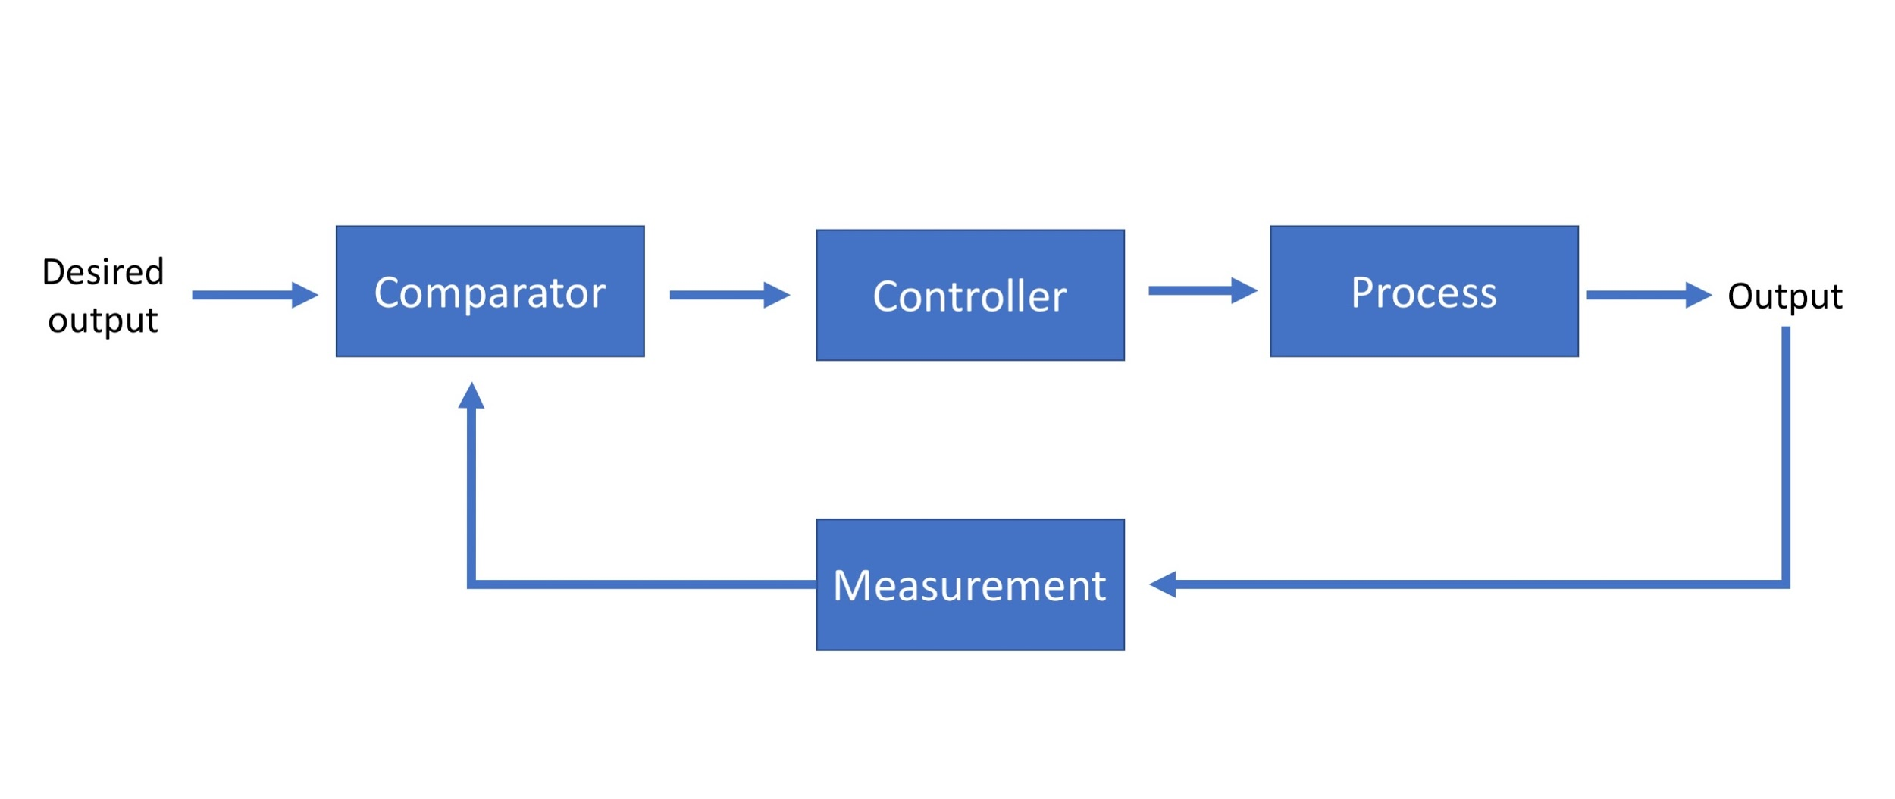
Control Loops (1)
Open loop
Closed Loop
Notes:
Open loop control is what you had before:
An input is desired - either from a joystick or from the code
That is modified by code to turn it into a value you can pass to the motor controller
Controller changes how much current it allows through into the motor
Which accelerates the robot
Closed loop control is what we’re proposing here
Same as before, but now we
measure the resulting motor speed and
compare it to the desired speed and
do something with the error to change the motor speed

Slide 8
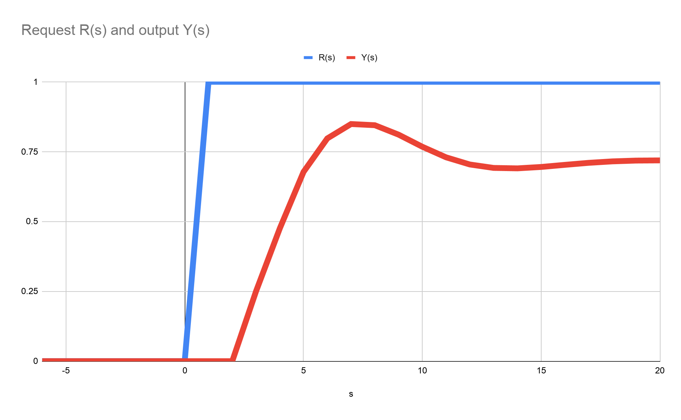
Control Loops (P only)
Proportional Control
Output to motor proportional to the Error between the Desired position and the Actual position
Can work, but sometimes leaves an offset (e.g. if the motor is under load)
Notes:
Think of the accelerator in a car. When you push down on the accelerator, the car accelerates
how fast that happens depends on how far down you press it
Now imagine we’re trying to hold a particular speed constant (like the cruise control)
Desired speed is fed in to the comparitor.
Lets imagine we want a particular speed and we set that as the desired speed. It will be constant for the rest of this example.
Take away the current speed from the desired speed to get an error
That error is multiplied by a Gain to get a control signal.
That signal gets sent to the motor controller and results in the motor speeding up
Next time round the loop, the error signal will be smaller because the motor is now spinning a little
That repeats.
If we had a totally frictionless system, eventually the speed would be constant at the desired speed, the error would be zero and the motor controller would be turned off
But in real life there’s always friction, so the system will settle at some constant speed where the error causes the motor controller to run at a rate which matches the friction losses.

Slide 9
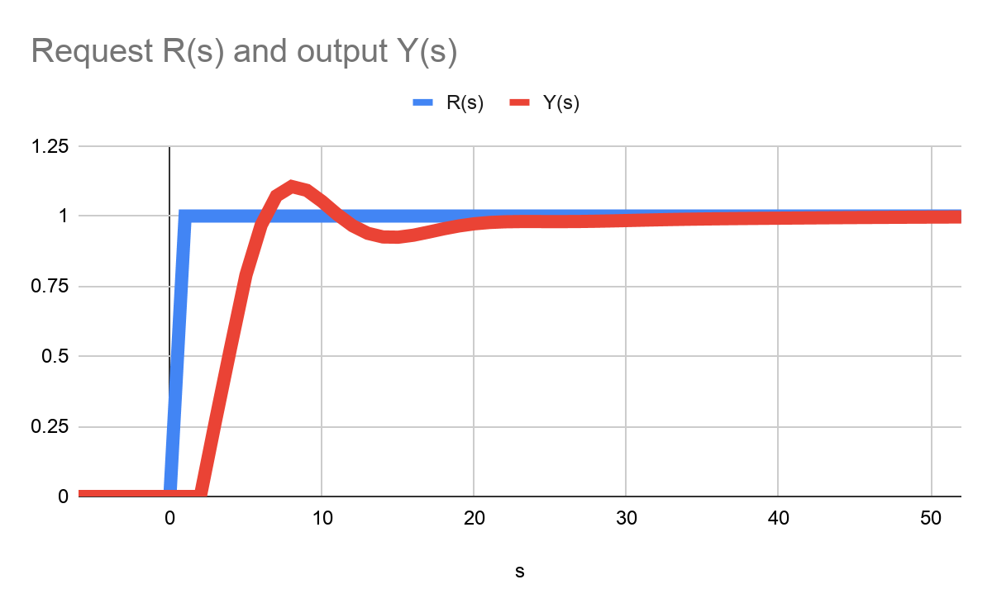
Control Loops (PI)
P-I controller:
Adds integral control
adds up error over time and adds that to the output signal
Corrects for offset
Can overshoot or oscillate
Notes:
Now we add an integral term to the controller.
The integral term integrates the error - that is every time we go round the loop, we add the error onto the previous integral value
So the Proportional Term will behave as we saw before - finding steady state at some constant offset from the desired speed.
But in this case the integral term will continue to increase until the error goes to zero (i.e. speed matches the desired speed)
So the integral term corrects any offset
The downside of it is that it causes overshoot or even oscillation around the desired speed.

Slide 10
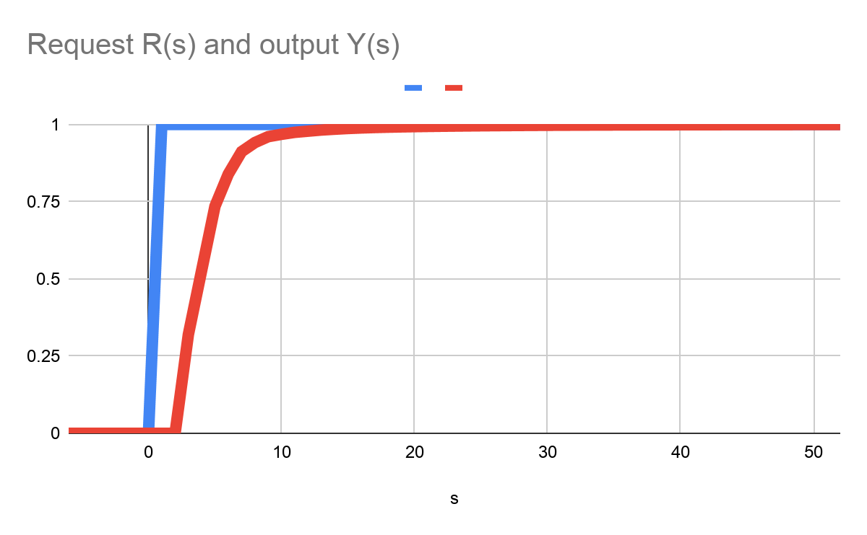
Control Loops (PID)
Full Proportional, Integral, Differential control
Adds differential term
Usually used for damping oscillations or overshoot
Intuitively:
higher P gain means sharper control
I term determines how hard the controller works against external forces
D gain works as a damper and reduces the over-correcting and overshoots
Notes:
If we have an oscillating system and we want to stop it oscillating, we want to cause “drag” on it - imagine trying to swing in treacle.
The differential term is like drag - it opposes the oscillations
So intuitively,
The Proportional gain gives faster, snappier control
The Integral gain determins how hard the controller works against external forces (like carpet or a slope)
The Differential gain acts like a damper to control oscillations and reduce overshooting

Slide 11
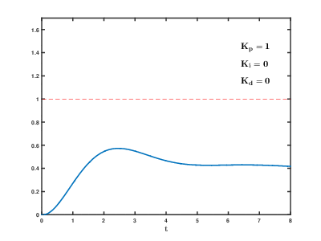
Tuning PID controllers
Tuning is picking the values of Kp, Ki, Kd
Bit of a black art…
Formal methods - google them:
Zeigler-Nichols
Tyreus-Luyben
Rivera, Morari and Skogestad
Basic approach:
Increase Kp until it oscillates, then back off a bit
Increase Ki until it gets to set point fast enough
Try increasing Kd to kill oscillations
-ve D might be needed…)
Notes:
Tuning is picking the values of Kp, Ki, Kd
Bit of a black art…
Formal methods - google them:
I’m not going to try to pronounce them all :)
My basic approach:
Increase Kp until it oscillates, then back off a bit
Increase Ki until it gets to set point fast enough
Try increasing Kd to kill oscillations, bearing in mind that a -ve D might be needed

Slide 12
PID controller hardware
Need to run very regularly
The higher the frequency, the faster they can react
Less likely to oscillate
Regularity is important
Consider running on a microcontroller
Tigerbot used a Pimoroni propellor hat to run the motor speed control
8 core microcontroller
used 1 core for talking I2C
1 core for PID
4 cores for counting quadrature encoder pulses
Heading hold should be fine on a Pi
Brian Starkey (@usedbytes) ran a heading hold loop at 60Hz (in golang)
Used a BNO055 Absolute Orientation Sensor for sensing
Notes:
As I said before, PID loops benefit from being run very regularly
The higher the frequency, the faster they can react
Less likely to oscillate
Regularity is important
Consider running on a microcontroller
Tigerbot used a Pimoroni propellor hat to run the motor speed control
8 core microcontroller
used 1 core for talking I2C
1 core for PID
4 cores for counting quadrature encoder pulses
Heading hold should be fine on a Pi
Brian Starkey (@usedbytes) ran a heading hold loop on Mini Mouse at 60Hz (written in golang)
Used a BNO055 Absolute Orientation Sensor for sensing

Slide 13
Turning that into code
Loop needs to run very regularly
Trigger it on a timer
Gains are per loop - so more loops per second = higher effective gain
If you change the loop period, you need to retune
The faster the loop runs, the more accurate the control can be
Quadcopter control loops run at 8Khz
Differential term - take the previous error away from current error
Integral term - add up errors - beware of it wrapping - may need to cap it
Risk of blowing your motor controller! Make sure you have current limiting (or a fuse)
Beware of maxing the signal to the controller
Beware of changing signal to the controller too fast
Notes:
Loop needs to run very regularly
Trigger it on a timer - don’t use a sleep
Each time you go round the loop, the controller does something - so the Gains are proportional to the loop frequency
If you change the loop period, you need to retune
The faster the loop runs, the more accurate the control can be
Quadcopters (which need very fast response times to not drop out of the sky), their control loops run at 8Khz
Differential term - take the previous error away from current error
Integral term - add up errors - beware of it wrapping - may need to cap it
Risk of blowing your motor controller! Make sure you have current limiting (or a fuse)
Beware of maxing the signal to the controller - commanding the controller to deliver maximum current to the motor (unless you’re certain all the components can take it)
Beware of changing signal to the controller too fast - because motors are inductive, you can blow your motor controller that way too

Slide 14
A real example (in spin for propellor hat)
b := i2c.get(speedbase+i)
desired_speed := ~b ' note sneaky '~' that sign extends the byte value
nextpos := quad.count(i)
last_error := desired_speed - actual_speed[i]
actual_speed[i] := (nextpos - lastpos[i]) * 3
lastpos[i] := nextpos
<snip>
error := desired_speed - actual_speed[i]
error_derivative[i] := error - last_error
error_integral[i] := (error_integral[i] * 100 / 99) + error
error_integral[i] := -maxintegral #> error_integral[i] <# maxintegral
newspeed := Kp * error + Ki * error_integral[i] + Kd * error_derivative[i]
<snip>
newspeed := (lastspeed[i] - maxpwmramp) #> newspeed <# (lastspeed[i] + maxpwmramp) ' set a maximum PWM ramp
setMotorSpeed(i, newspeed)
lastspeed[i] := newspeed
https://github.com/tigerbot-team/tigerbot/blob/master/metabotspin/mb3.spin
Notes:
So here’s a real example of the speed control loop from Tigerbot
Written in Spin which is the language for the Propeller microcontroller
b := i2c.get(speedbase+i)
Gets desired speed over I2C
nextpos := quad.count(i)
Get current position from the core running the quadrature encoder counting
last_error := desired_speed - actual_speed[i]
Calculates last error using the desired speed and taking away the actual speed from the last time it looped
actual_speed[i] := (nextpos - lastpos[i])
Calculates the current actual speed
lastpos[i] := nextpos
Copies current position into lastpos
error := desired_speed - actual_speed[i]
Calculates the error term
error_derivative[i] := error - last_error
Calculates the error derivative term - by taking away the last error from the current error
error_integral[i] := (error_integral[i] * 100 / 99) + error
Calculates the error integral term - by adding the current error to the sum of errors so far
error_integral[i] := -maxintegral #> error_integral[i] <# maxintegral
Caps the error integral (to prevent “winding up” and wrapping
newspeed := Kp * error + Ki * error_integral[i] + Kd * error_derivative[i]
Calculates the new_speed setting
setMotorSpeed(i, newspeed)
Sends the new_speed setting to the motor controller
Lastspeed[i] := newspeed
Copies the new_speed into lastspeed ready for the next loop
There’s a link to the file this code is taken from in case you want to look at it again later.

Slide 15
Summary
Need sensors to measure the thing being controlled
PID loops can run on Pi, but for really fast response, consider a microcontroller
PID controllers need tuning
But a well tuned controller will make the robot more controllable
PID controllers can compensate for the environment
Slopes, rough surfaces, turntables
Autonomous events are much easier with a PID controlled robot

Slide 16
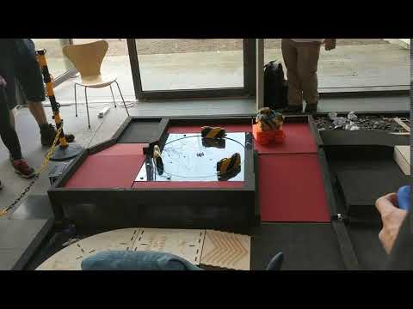
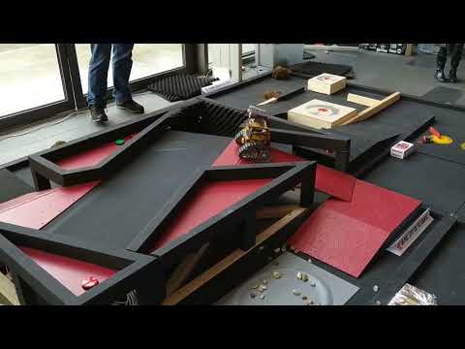
Any Questions?

