Slide 1
CERC BOT’s Pi Wars Journey ’To boldly go where no Pi Bot has gone before’
Presented by Rishan Sharma - CERCBot team
Notes:
Introduce yourself and mention team apologies that many couldn’t make it here. And I was keen at Pi Wars and couldn’t resist this opportunity.

Slide 2
Contents
The start of our Pi Wars journey
The making of the robots (as in V1, V2, etc.)
Deep dive into one of the challenges
How we progressed through the final day
Notes:
Slide number not included.

Slide 3
Pi Wars 2019 - Recap
For those who don’t know, Pi Wars is a robotics challenge using Raspberry Pi as the main component. These are the challenges:
Autonomous
The Hubble Telescope Nebula Challenge – We came 3rd in this challenge.
The Canyons of Mars – We came 1st for this challenge.
Blast Off: the Straight-ish Line Speed Test – We came 7th for this challenge
Remote Controlled
Pi Noon: The Right Stuff
Space Invaders – We came 1st for this challenge.
Spirit of Curiosity – We came 4th for this challenge.
The Apollo 13 Obstacle Course – We came 16th for this challenge.
Notes:
Slide number not included

Slide 4
The Beginning – Where Everything Started

Slide 5
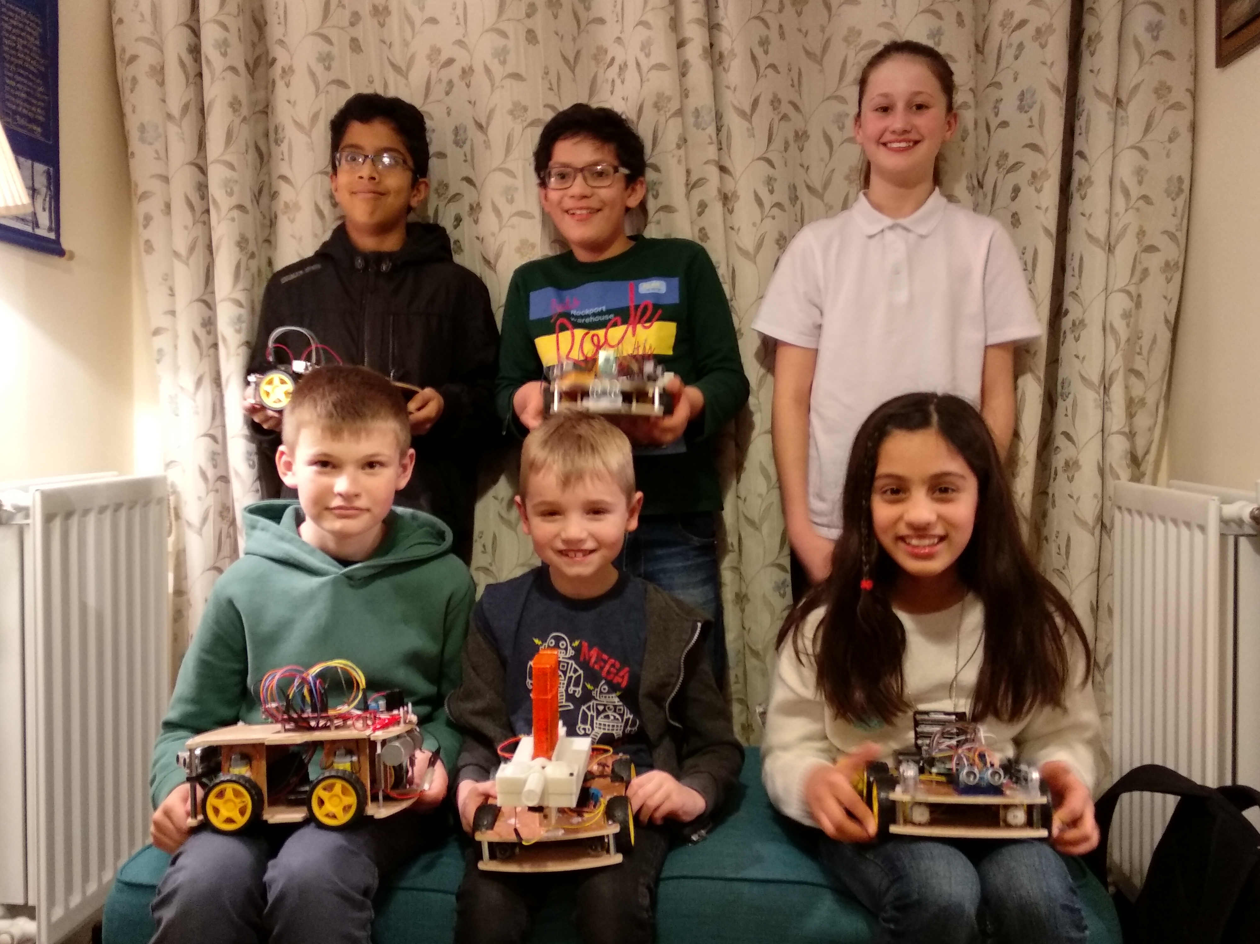
Team CERCBOT in the making
One sunny morning, I had come up of a brilliant idea: Our local programming club could join Pi Wars, not only that, it would also be great experience for the young coders. So, at the following coding session, I suggested the idea to the club mentor, and he gave a very enthusiastic, ‘Yes!’.
In the following session, it was announced that whoever wanted to take part could provide there names so we could form a team. We got 8 responses, 2 of which withdrew at a later time.
6 of us formed the final Pi Wars team. It was a very varied team.
The six members of CERCBOT(from bottom left): Ewan, Leo, Saachi, Vrishin, Rishan, and Sadbh
Notes:
One sunny morning, I had come up of a brilliant idea: Our local programming club could join Pi Wars, not only that, it would also be great experience for the young coders. So, at the following coding session, I suggested the idea to the club mentor, and he gave a very enthusiastic, ‘Yes!’. In the following session, it was announced that whoever wanted to take part could provide there names so we could form a team. We got 8 responses, 2 of which withdrew at a later time.
6 of us formed the final Pi Wars team. It was a very varied team. Some of us were beginners with coding of any sort, while some were playing with microbit (Scratch etc.) and some were playing on Raspberry Pi, only one thing bound us together: we were all enthusiastic at the prospect of driving a robot through rocky surfaces, popping balloons, and autonomous colour detection.
Team profile

Slide 6
Team CERCBOT’s Plan
Overview the challenges
Analyse what everybody needed to learn
Individually kick-start everyone with kits(V2) which the could use to get a feel of Raspberry Pi
Communicate each other easily and efficiently
We discussed the difficulty of the challenges and confirmed that it will be best that every person, or partner focusses on one challenge each.
Some of the team had not touched a Raspberry Pi whilst most of the team had been programming for a couple of years – but not of Raspberry Pi, sensors
So, we decided that experienced programmers would help inexperienced programmers in booting up and guiding them through the setup.
We discussed and decided that we needed a properly dimensioned robot (V2) which team members could use to play with and add sensors such as ultrasonic sensors, Pi Camera, line sensor, motors until they are comfortable and can control them with ease. After a couple of months, they were able to spin around, change speed, read live data, use simple loops in their code like ‘if and else’.
Communicate each other through WhatsApp, GitHub and bi-weekly sessions.
Notes:
After a week of excitement, we finally got down to business. We decided to meet at our club mentor’s house to discuss the following:
Overview of the challenges.
Analyse what everyone needed to learn.
To individually kick-start everyone with kits (V1) which they could use to get a feel of the Raspberry Pi.
How to communicate with each other (WhatsApp, GitHub, and bi-weekly club sessions).

Slide 7
Team Coordination
When we all had a clear picture of our robot and code, we all had one big question: How will we share the code with each other? We decided that Github would be the best. Our Github repository is at: https://github.com/andrewfell/CERC-PIWars2019

Slide 8
The Build of the Robots

Slide 9
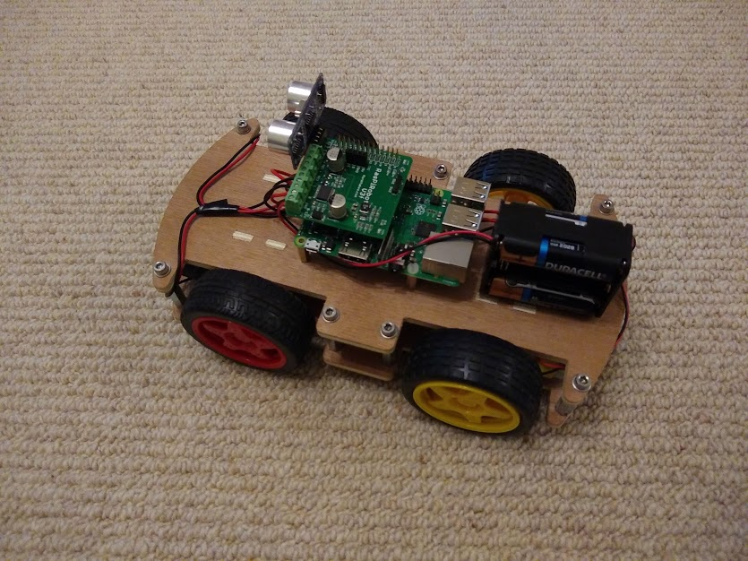
The Build – V1
Battery pack which are connected to the Raspiro.
Ultrasonic sensor used for checking if the robot has hit a wall
Raspiro motor controller board which drive the motors.
The Raspberry Pi 3 used for crunching the data from the ultrasonic sensors.
Motors, which are controlled from the motor controller

Slide 10
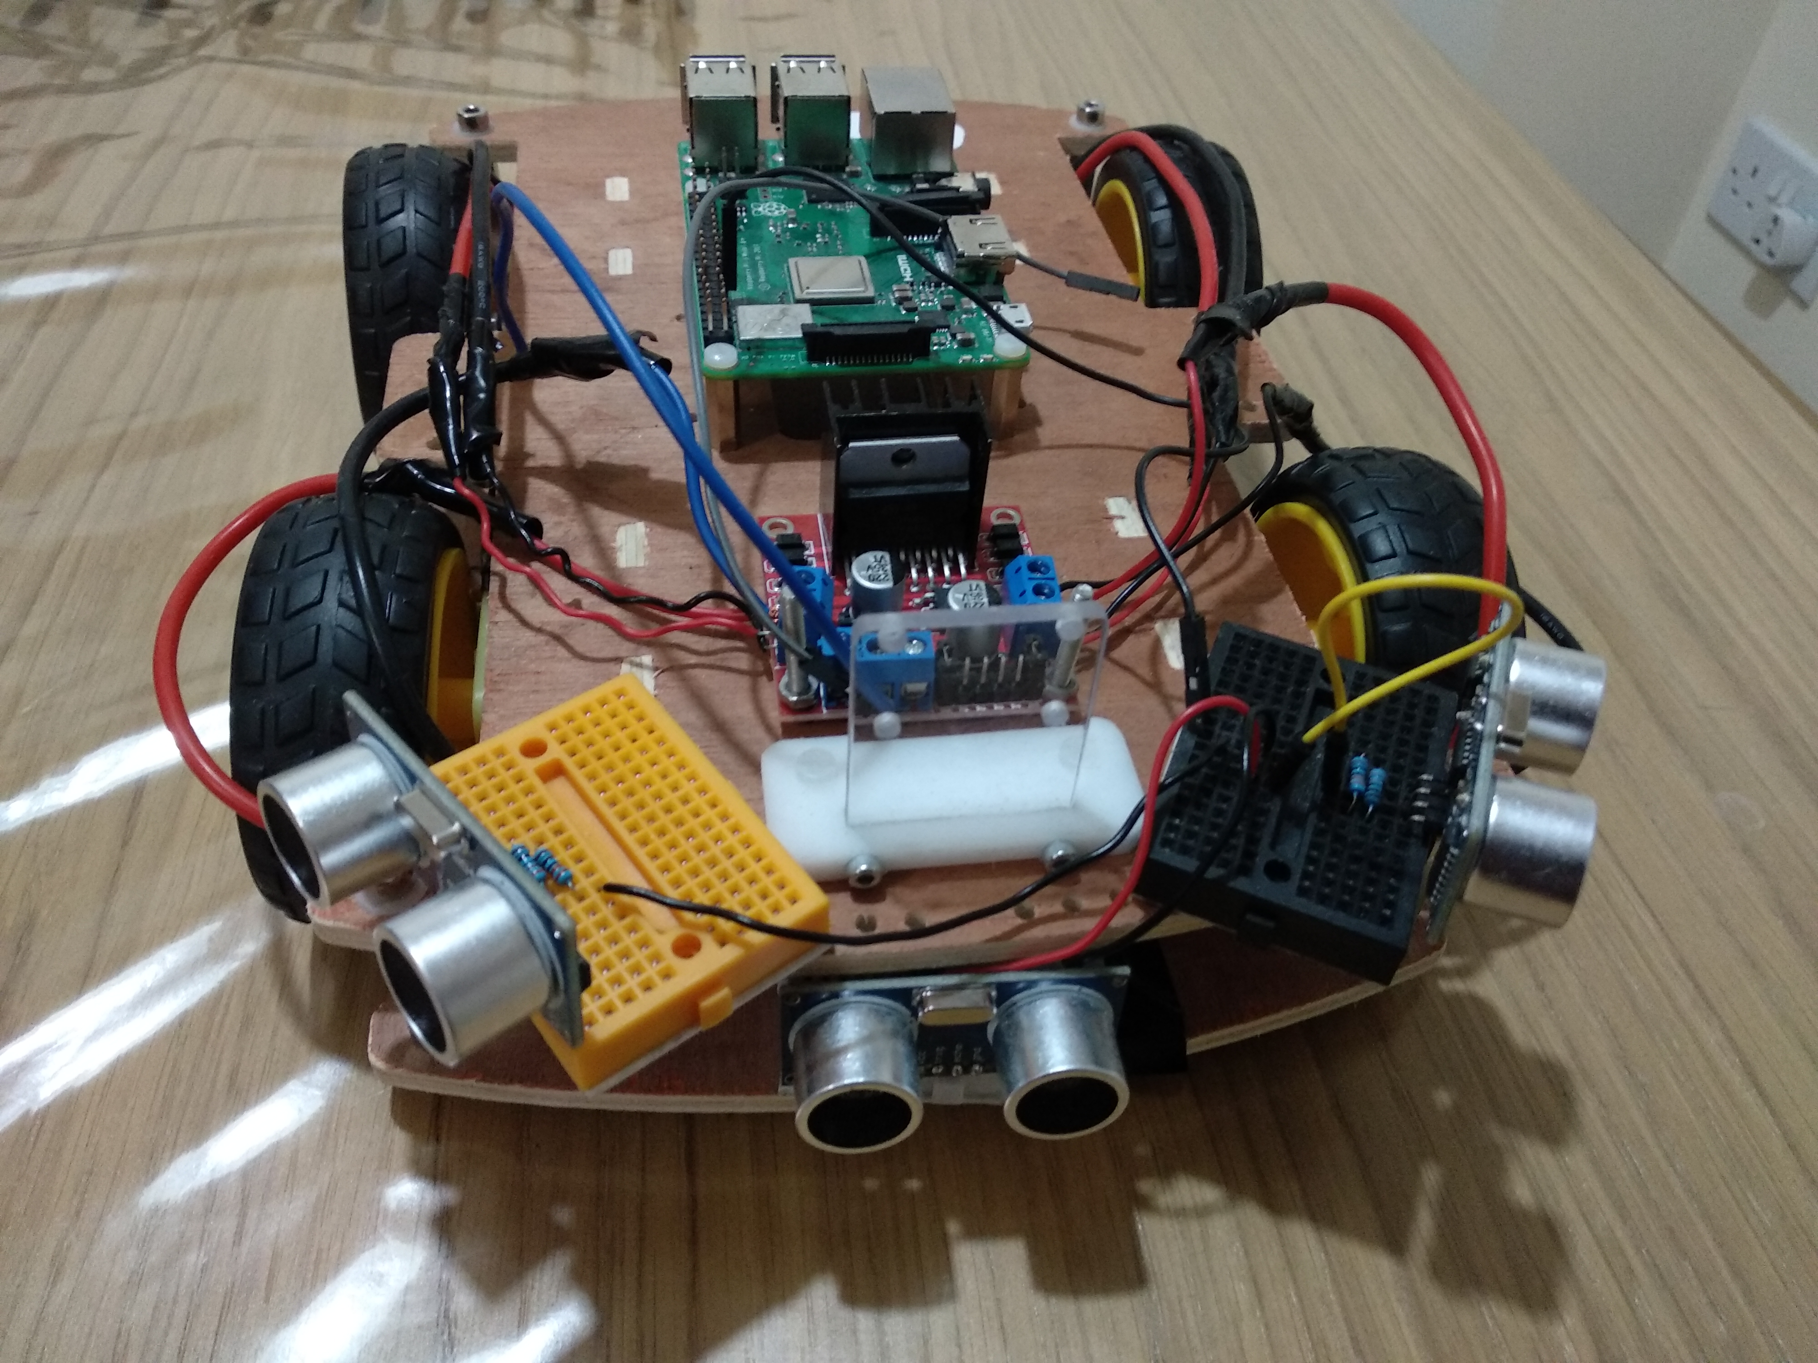
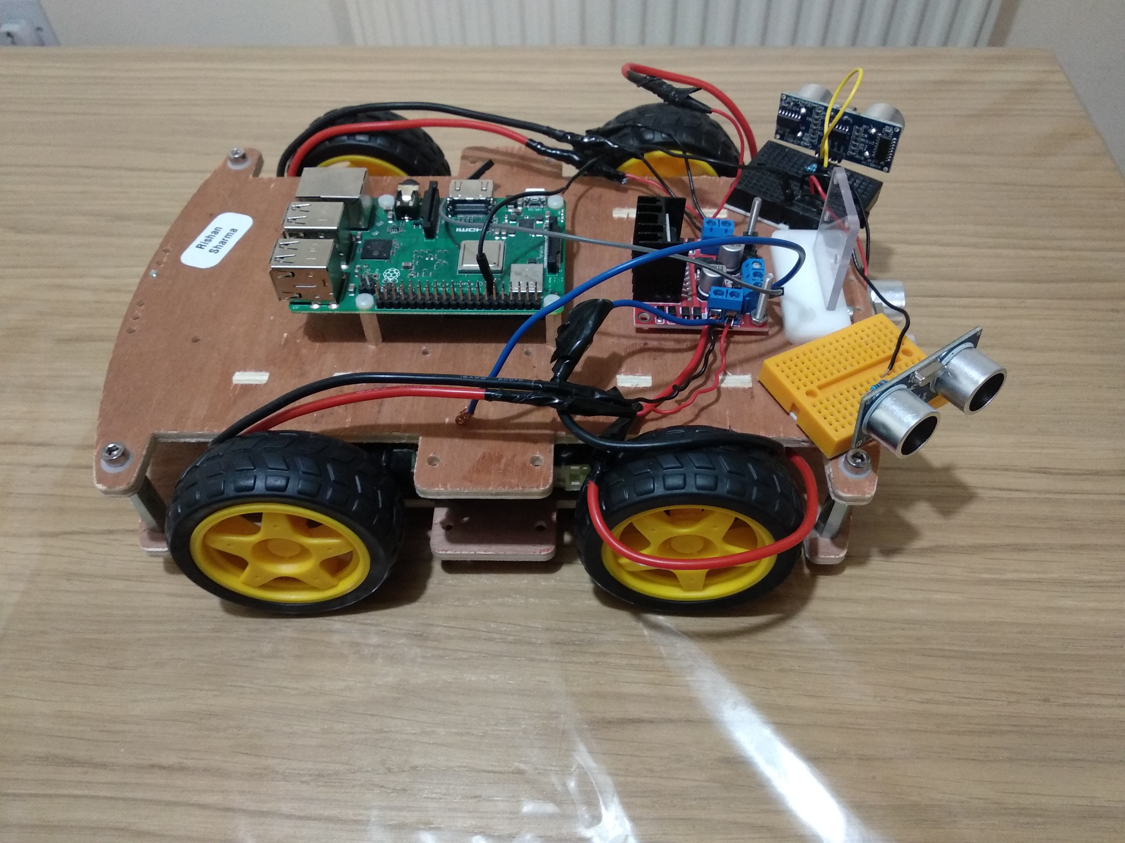
The Build – V2
Raspberry Pi, for processing data from sensors and Pi Camera.
Motor controller for controlling the motors, controlled by the Raspberry Pi
17cm
25cm
6cm
Camera mount for mounting camera, which is used for the Nebula Challenge.
Three ultrasonic sensors for more accurate sensing.

Slide 11
The Problems of the V2
The V2 robot was a roughly designed robot, there were numerous problems that are listed below:
The robot was small, resulting in these effects:
The robot didn’t have enough space to add extra items such as the gun, and the balloon extension for Pi Noon.
It was very small, therefore resulting in very fiddly connections.
There was no space for a 4x AA battery pack so it kept on falling off.
Need for adjustable components
The ultrasonic sensors were supposed to be perpendicular for the maze challenge, whilst in the Nebula challenge they needed to be at an angle.
The camera was too high, sow we needed to crop the top of the image out in the software
When the robot crashed into a wall, the camera would get damaged

Slide 12
All this work leads to . . .

Slide 13
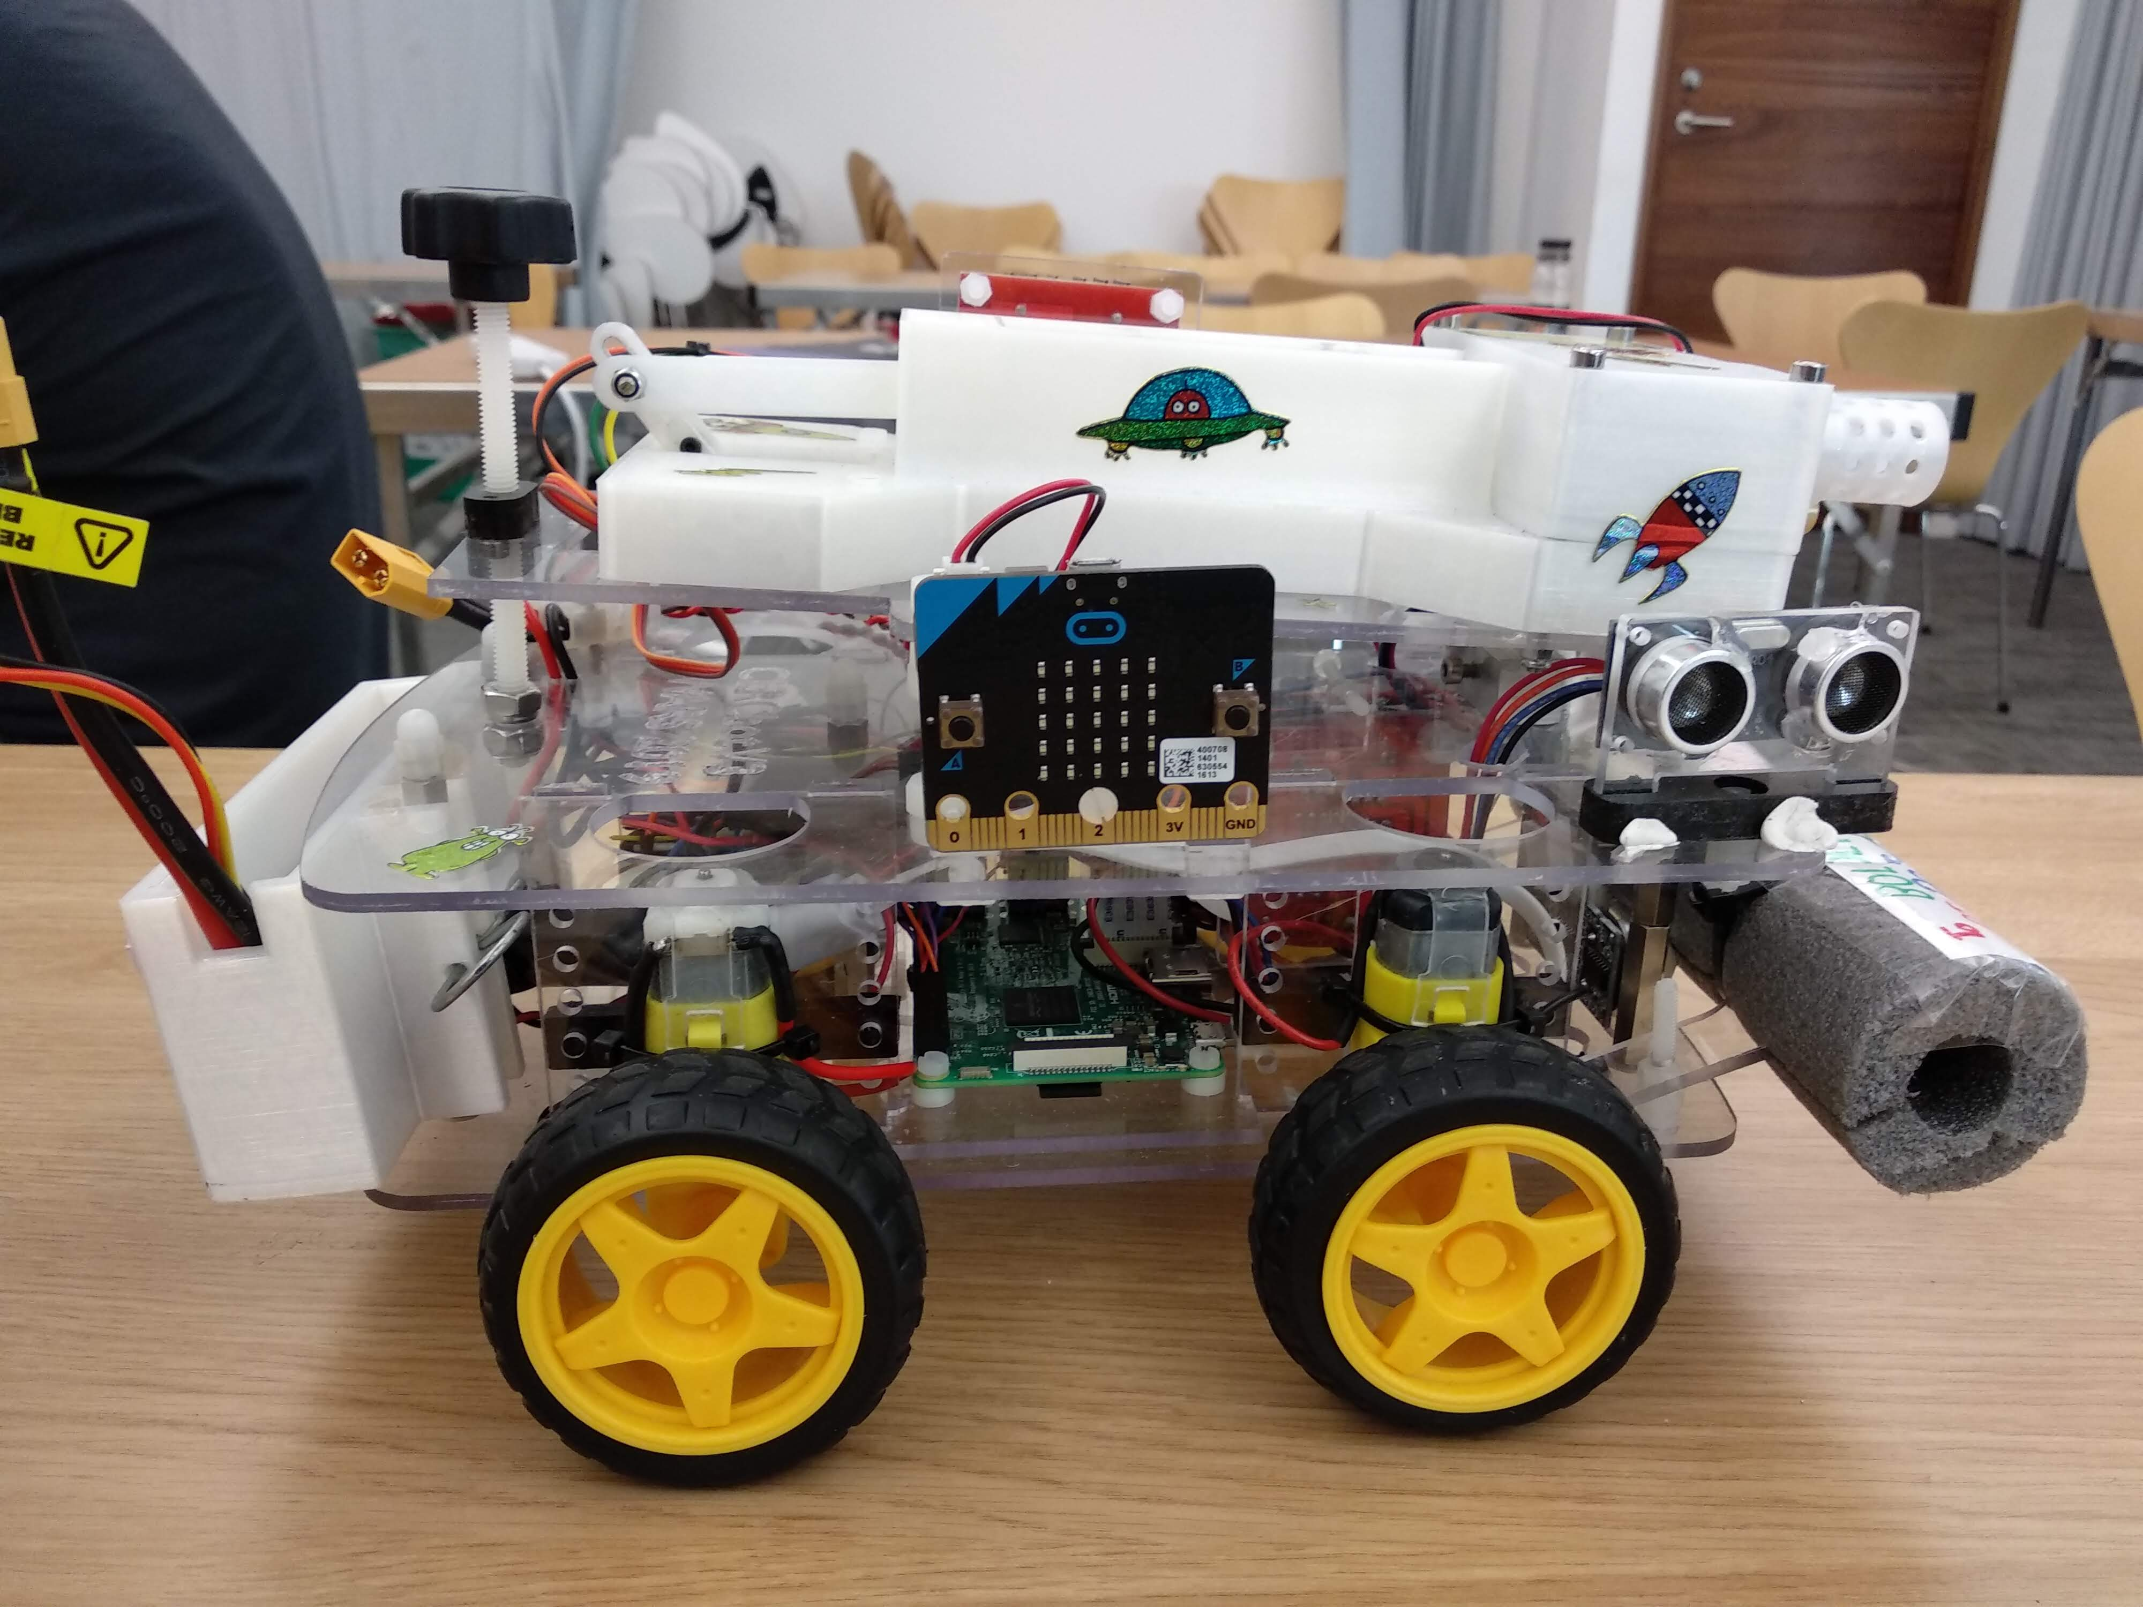
The Build – V3
Pi Camera is protected because it is behind chassis
Adjustable ultrasonic sensors for different challenges.
All of the components are fitted inside the main body.
Adjustable gun for the Space Invaders challenge.

Slide 14
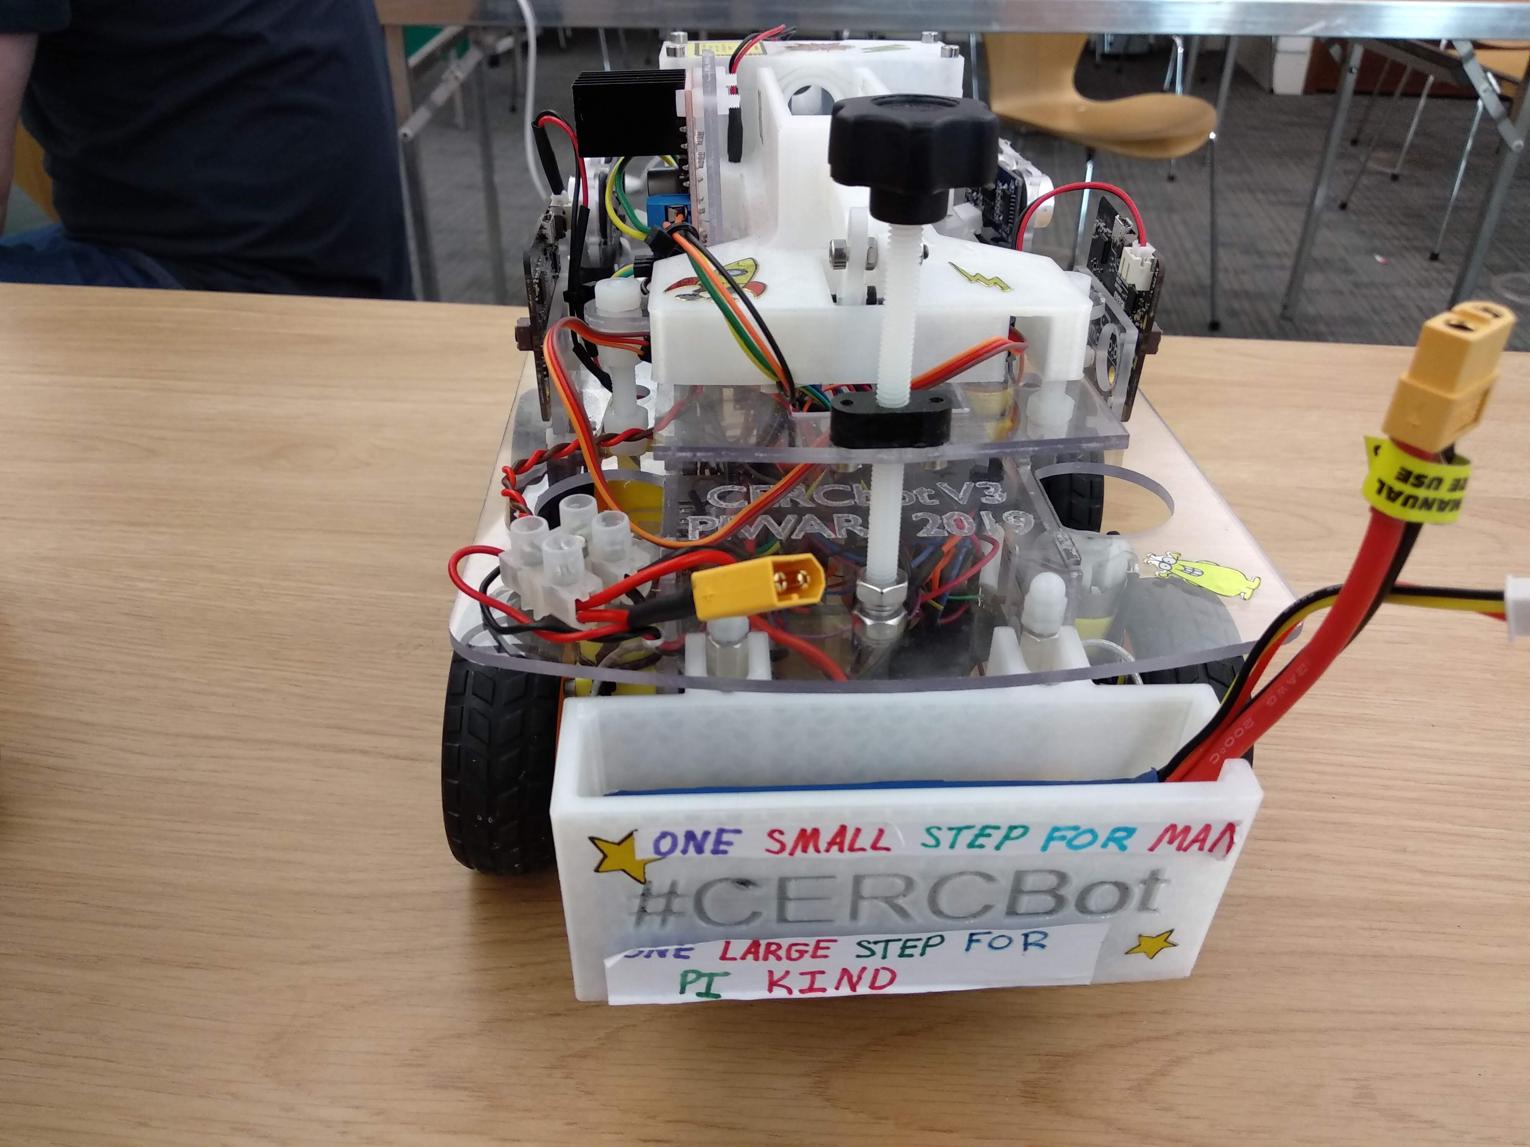
The Build – V3
Battery holder.
LiPo battery for motor controller

Slide 15
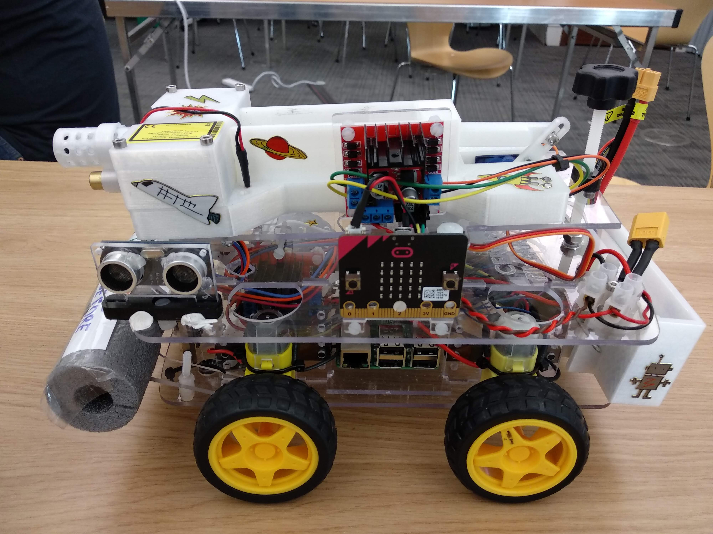
The Build – V3
Motor controller
Micro: Bit for display.

Slide 16
The Build – V3
Battery holder.
LiPo battery for motor controller

Slide 17
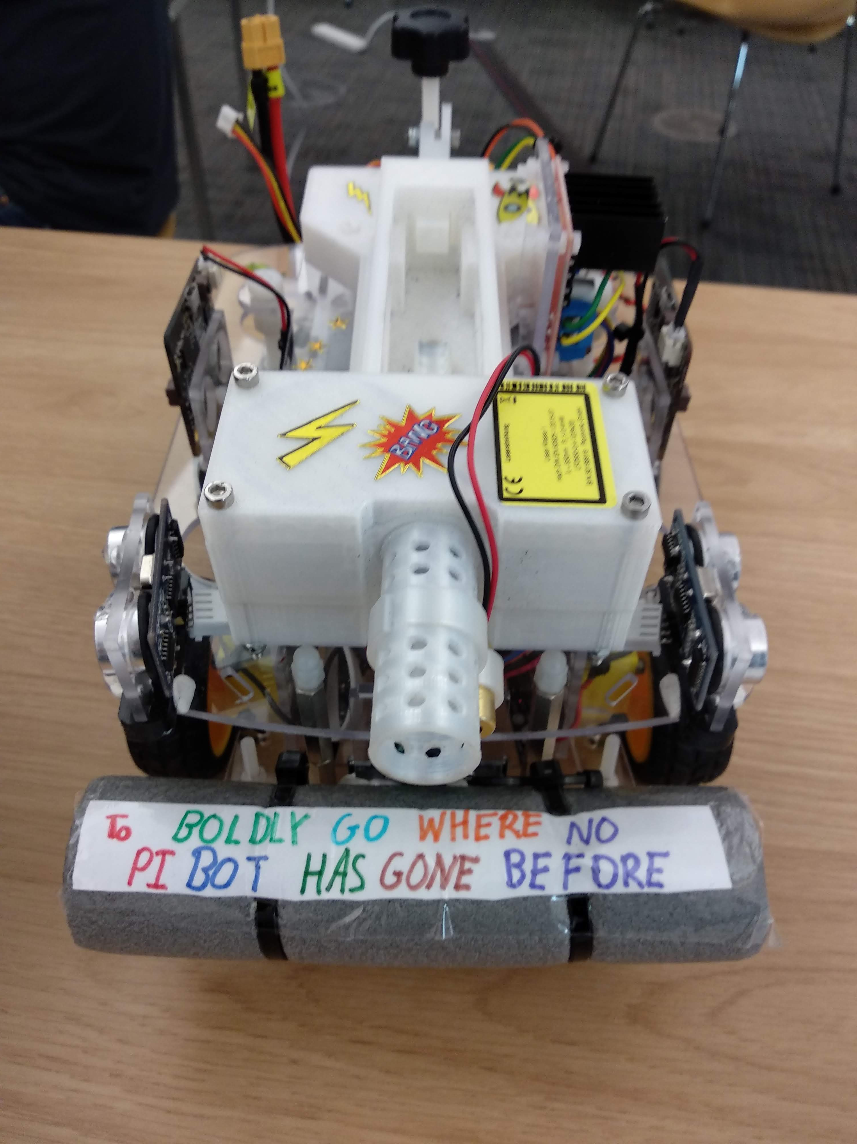
The Build – V3

Slide 18
Deep Dive Hubble Telescope Nebula Challenge
Notes:
In the next few slides, I am going to talk about what I think is the most interesting, but most difficult challenge overall in the competition. I am talking about the Hubble Telescope Nebula Challenge. When I first heard that I was going to be assigned this challenge, I had quite a lot of doubts about whether I could manage it. This was my first dip in computer vision programming and I still do it to this day.

Slide 19
Beginning with Nebula Challenge
My First Few Thoughts about the Challenge
Completely new !!
No knowledge about computer vision
Doubts about needed programming knowledge
Initial Planning
Computer vision using OpenCV
Found about in Magpi issues
Got some articles for colour coding scheme with RGB and HSV.
Got a book called – Learning OpenCV 3 Computer Vision with Python
Decided to have a test area
Notes:
In the next few slides, I am going to talk about what I think is the most interesting, but most difficult challenge overall in the competition. I am talking about the Hubble Telescope Nebula Challenge. When I first heard that I was going to be assigned this challenge, I had quite a lot of doubts about whether I could manage it. This was my first dip in computer vision programming. After thinking all about this, I had stumbled on a problem that is probably quite obvious now: how are we going to test my programs after I’ve made them? This problem was easily solved with 6 wooden planks from B&Q (4 for the sides, 2 for the base).
OpenCV – Used for computer vision, found about in Magpi issues but I have never seen it in action.

Slide 20
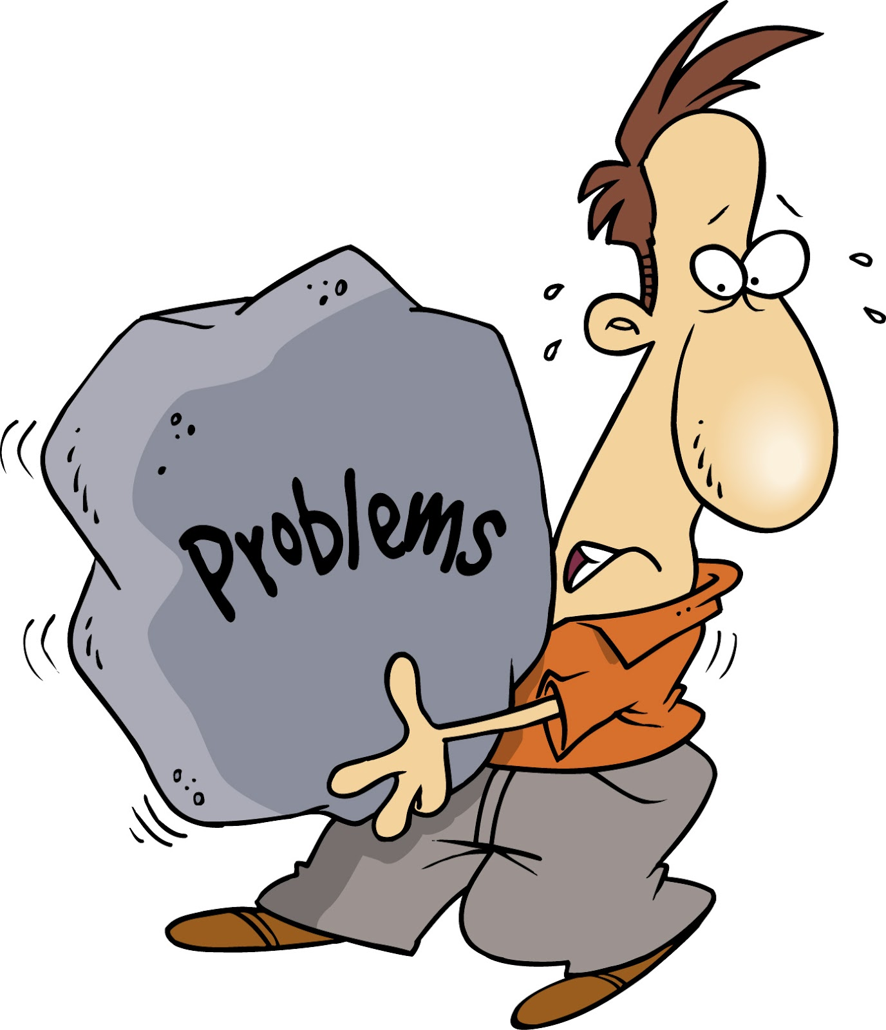
The A – Z of Problems

Slide 21
Open CV Compilation
While installing OpenCV, we were following this link: https://www.pyimagesearch.com/2017/09/04/raspbian-stretch-install-opencv-3-python-on-your-raspberry-pi/
It was extremely useful, but too time consuming (nearly a day!) for installing OpenCV. One day, while OpenCV was compiling on Raspberry Pi, the LiPo battery lost its power and shut down, therefore resulting in a corrupt SD card. We had to install Raspbian again and download OpenCV but this time, powered by mains.

Slide 22
Robot’s eyes are too sensitive to shiny surfaces!
Glossy paint in the test causes interference with colour differentiation. Due to this, the robot goes straight into the wall. For instance, when the robot is going towards the colour green, the starting LED of the Raspberry Pi, which is green in colour, got reflected by the black wall and went straight into it. To tackle this problem, we placed a blank sheet of black, which isn’t reflective, over the walls and floor of the test course. We used different temperatures of light, but our closed one was 1500 Kelvin.
???
Notes:
Glossy paint in the test causes interference with colour differentiation. Due to this, the robot goes straight into the wall. For instance, when the robot is going towards the colour green, the starting LED of the Raspberry Pi, which is green in colour, got reflected by the black wall and went straight into it. To tackle this problem, we placed a blank sheet of black, which isn’t reflective, over the walls and floor of the test course.

Slide 23
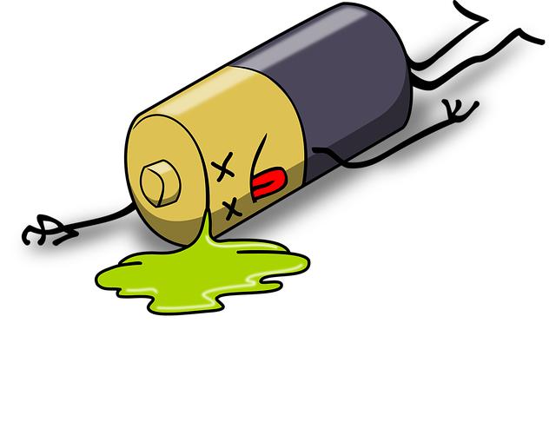
AA Batteries … Only to be succeeded by LiPo!
When testing, the 6x AA batteries would run out very quickly. Due to this, the motors on the V2 robot would go VERY slow. We tried out different types of batteries, including 12v batteries. We eventually decided to use LiPo batteries which lasted the entire of the Pi Wars 2019 event.
AA
LiPo
Notes:
When testing, the 6x AA batteries would run out very quickly. Due to this, the motors on the V2 robot would go VERY slow. We tried out different types of batteries, including 12v batteries. We eventually decided to use LiPo batteries which lasted the entire of the Pi Wars 2019 event.

Slide 24
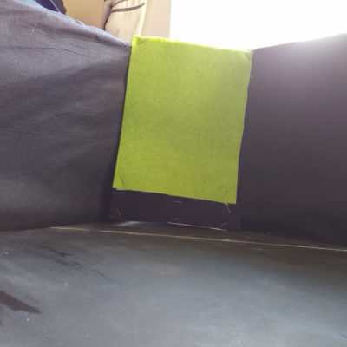
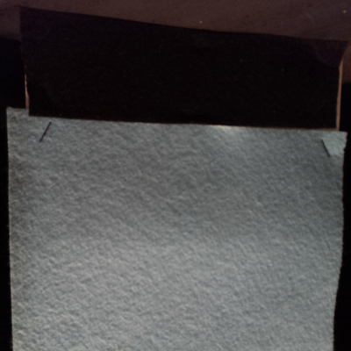
HSV vs. BGR… HSV wins!
Whilst testing, I used the colour space called BGR (Blue, Green, and Red) which, unfortunately, was VERY sensitive. Due to this, the robot was very inaccurate (look below). To solve this, I changed the colour space to HSV (Hue, Saturation, and Value) which, was much more easier to work with.
What colours do you think this are?
Ans: Yellow
Ans: Blue
Notes:
In different lighting conditions, that colours appear a different colour. Due to this, OpenCV didn’t find the colour in the course at all so the robot keeps on going round, trying to look for the colour. For example, when the Pi is looking for yellow, the Pi sees green instead of yellow. To solve this, we added lighting to the middle of the course (to give it uniform lighting) when earlier there wasn’t any lighting at all. We also changed to HSV (Hue,Saturation and Level) from BGR (Blue, Green and Red) format because it is less sensitive to light (Hue does not change much with different light conditions).

Slide 25
Autonomous robot fails … Remote controlled robot wins!
Whilst testing, we found out that when the robot goes near enough to the colour, it’s shadow falls on the colour, so the robot thinks that there is no colour. Due to this, the robot is stuck in a deadlock because when the robot turns left, the left UDS says, ”Stop! You’ll crash into the wall!” so the robot turns right, and the right UDS says the same thing. To tackle this, we used an app called Blue Dot.

Slide 26
Control using Blue Dot
Blue Dot is an app that can be connected to your Raspberry Pi and you can control it from your phone by Bluetooth. It was designed by Martin O’ Hanlon.
We used Blue Dot for telling the robot when to start the program and to tell it when a colour has been completed. It is much easier to use because it has a simple to use interface, and can have a lot of uses.

Slide 27
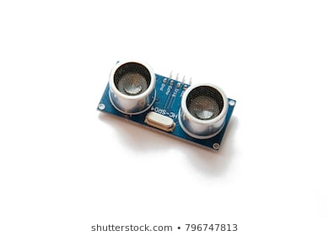
The Problem of Ultrasonic Sensor
Ultrasonic sensor’s pulse width times out because of Python library errors. Due to this, the ultrasonic sensor caused the robot to make wrong decisions like ramming into the wall because the sensor isn’t making the robot stop. To fix this, we used the RPi.GPIO library, which is the foundation library of Gpiozero’s OutputDevice and InputDevice library.

Slide 28
The Testing Area/Testing Strategy
To run our programs, we needed to have a testing area. We made a testing area with the correct dimensions. Thanks to B&Q, the length of the plank was the exact length of the actual area, so all we needed to do was cut the plank in half.
When we went to Makespace, to make use of the testing area, we realised that the lighting conditions were different to ours (as discussed previously). We took pictures of the colours but we couldn’t do much because we didn’t bring our Ethernet cable and we didn’t know our robot’s IP address

Slide 29
Code Flow Chart-1

Slide 30
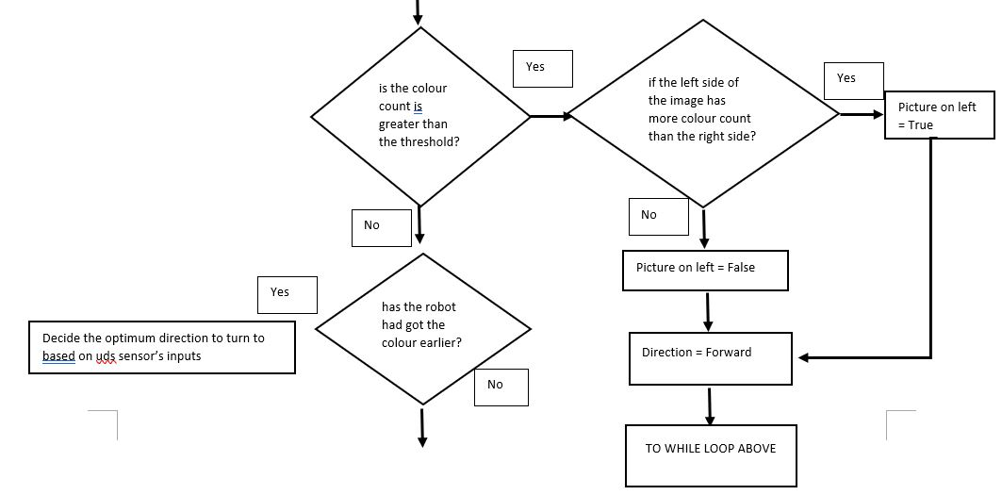
Code Flow Chart-2

Slide 31
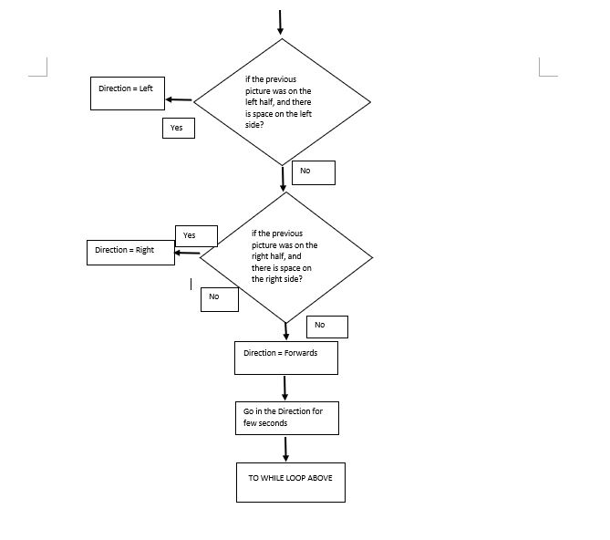
Code Flow Chart-3

Slide 32
Code Browse Through
Browse Through:
https://github.com/andrewfell/CERC-PIWars2019/blob/master/RobotV3/rishan_nebula_main.py
Key points
Using Open CV, NumPy
HSV based – more accurate than RGB
Based on picture every <> seconds (NOT Video – something for next time !) – Leading to slow movements
Decision of presence of desired colour
Find out if the colour it is looking for is the most dominant colour in the image
Find out if pixel count is greater than the assigned threshold
Check for mistake of touch in Blue Dot

Slide 33
How we progressed through the final day
10:55 AM – Apollo 13 Obstacle Course – Brilliant, Nice and quick
Everybody had a chance to steering the robot
12:10 PM – Straight-ish Line Speed Test – Huge failure, robot kept on crashing into to the turn
12:30 PM – Pi Noon Round 1 – Amazing, fortunately, opponent’s robot was not responding to their controls
We decided that the person who was controlling the robot should do it for all the rounds
1:15 PM – Spirit of Curiosity – Not bad, rocks kept on falling off
2:10 PM – Hubble Telescope Nebula Challenge – Amazing, 3 minutes (average) per round

Slide 34
How we progressed through the final day
Technical/Artistic Merit
Added 2 Micro: Bits for displaying the team’s name and the names of the people in the team, and cool stickers
2:40 PM – Pi Noon Round 3 – Brilliant
3:15 PM – Canyon of Mars – Good, missed out the final turn
3:40 PM – Pi Noon Round 4 – Lost, but played well
4:10 PM – Space Invaders – Amazing, and accurate, bullets were fast and powerful

Slide 35
Acknowledgements
Many thanks to our esteemed parents/mentors:
Alok Sharma
Sujit Bhattacharya
Andy Fell
Stuart Hunt
Akshaye Sama
Eamonn
35/35

Slide 36
Questions?
Video
https://youtu.be/dCizj19_sp4

